Slide 1
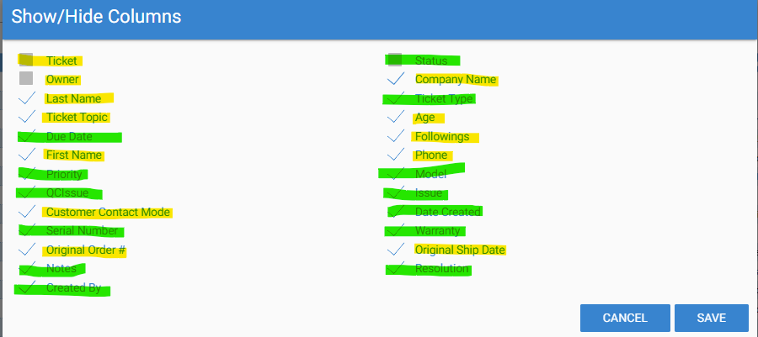
Comparing TTS X BC Ticketing main list
Missing Ticket number on main list
Assigned to in BC = Owner – leave as it is
This is the Customer name – missing on main list
This is the Customer Contact name – Missing on BC
Ok
This should be available on the main list
This is the time between date creation to close – it is missing
It is not available on BC but is ok
This is the Customer Contact name – First and last name can be one info
It is not available on main list but is ok
Should be available on the main list
Should be available on the main list – not a mandatory field
This comes from Sales Order#. Should be available on main list
This is the “Username” who created the ticket - OK

Slide 2
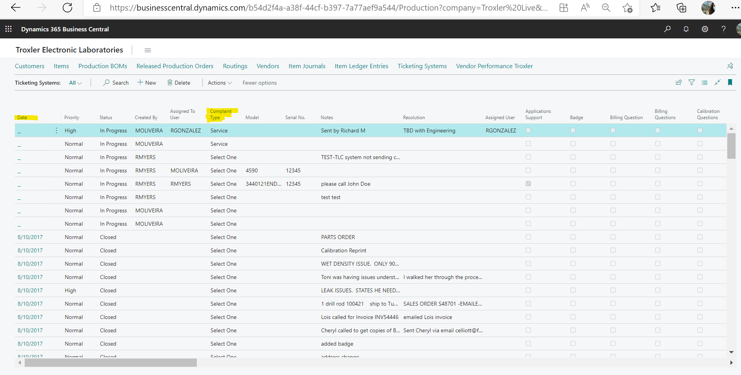
BC Ticketing main list
Missing Ticket number on main list [should be the first item] and should have the link to enter on the ticket
Missing ticket date here – it’s blank
Complain type → this is not a complaint type but “Ticket type” and needs to be a mandatory field
Add Ticket topic after Ticket type

Slide 3
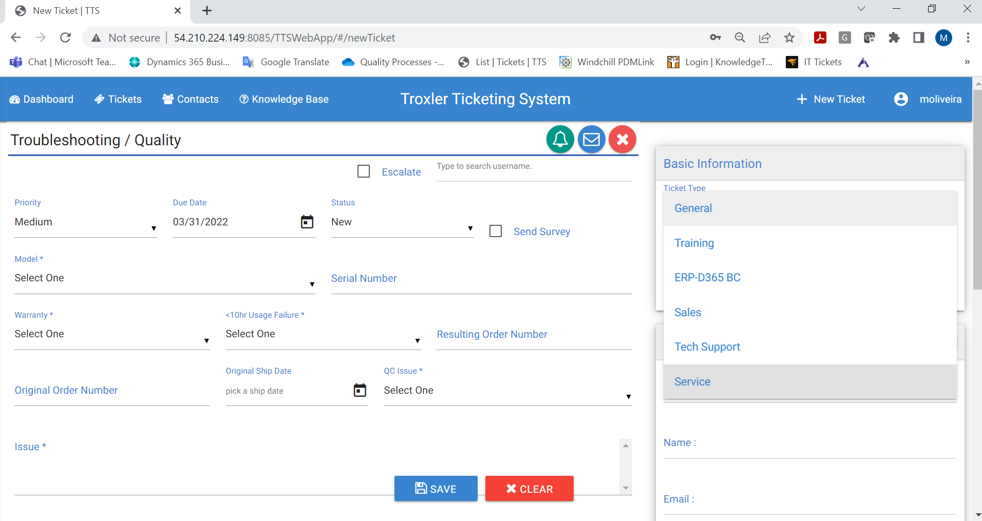
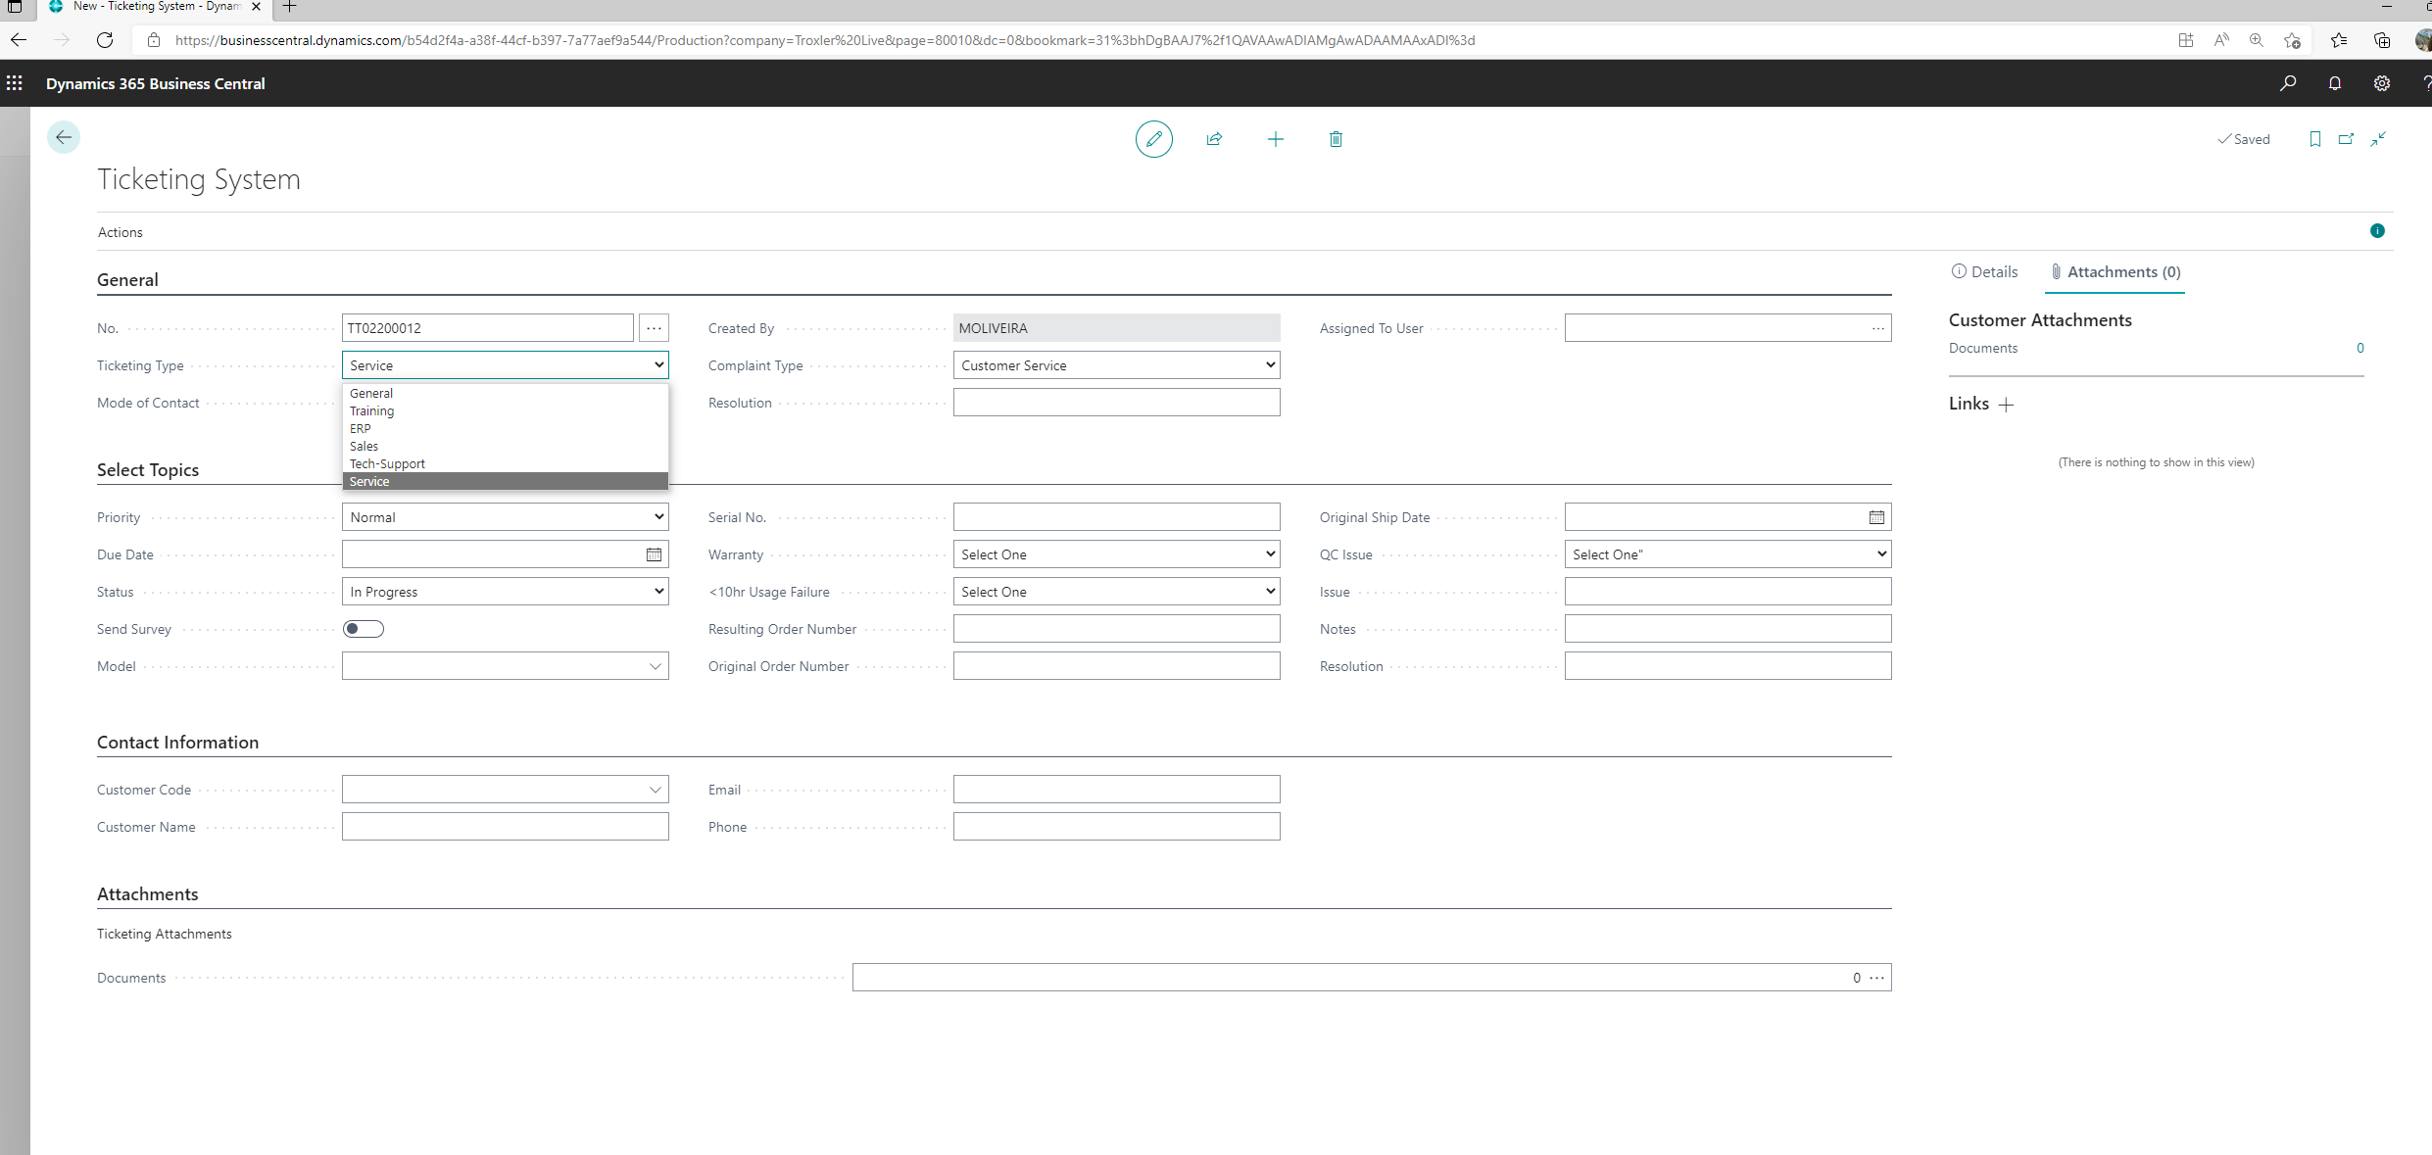
BC Ticket by Ticket type
Ticket type is according TTS and it is a mandatory field - OK

Slide 4
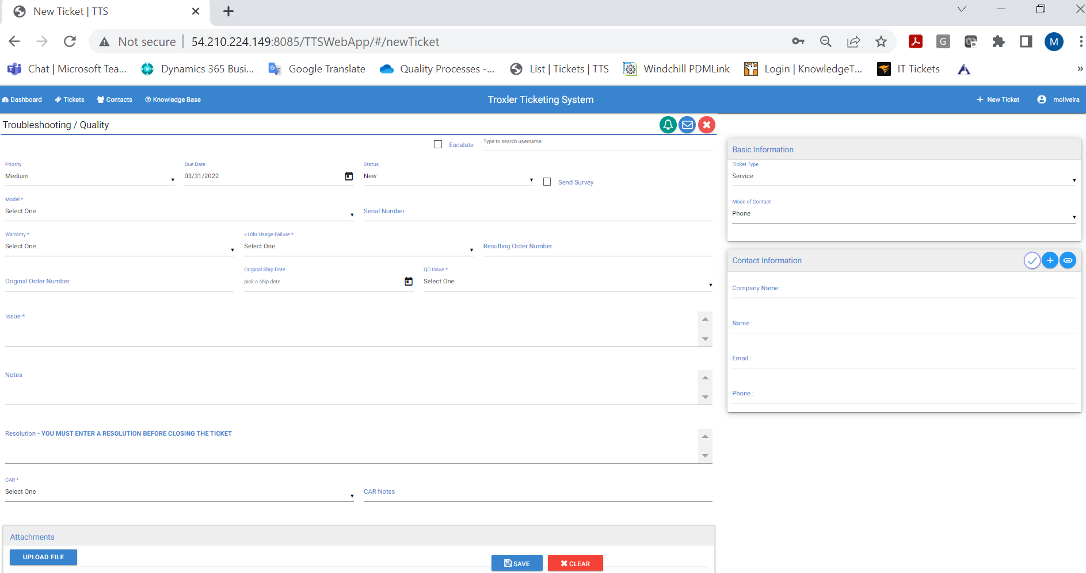
BC Ticket by Troubleshooting Quality
When pick Service ticket in BC automatically pops-up the TS quality fields but there is not spot to select this option
Add “Troubleshooting Quality” to the “Complaint type” to be available on the main menu
Remove Resolution from the General header and create a new sub header for: Issue, Note, resolution – these need to be big fields on the screen as in TSS - see here
Issue field needs to be big field [1000cc]
This is the customer contact name from Contact master
Notes field needs to be big field and very visual [1000cc]
Resolution field - leave only one resolution field [1000cc]
CAR [Yes/No] missing
CAR Notes [Open field] missing

Slide 5
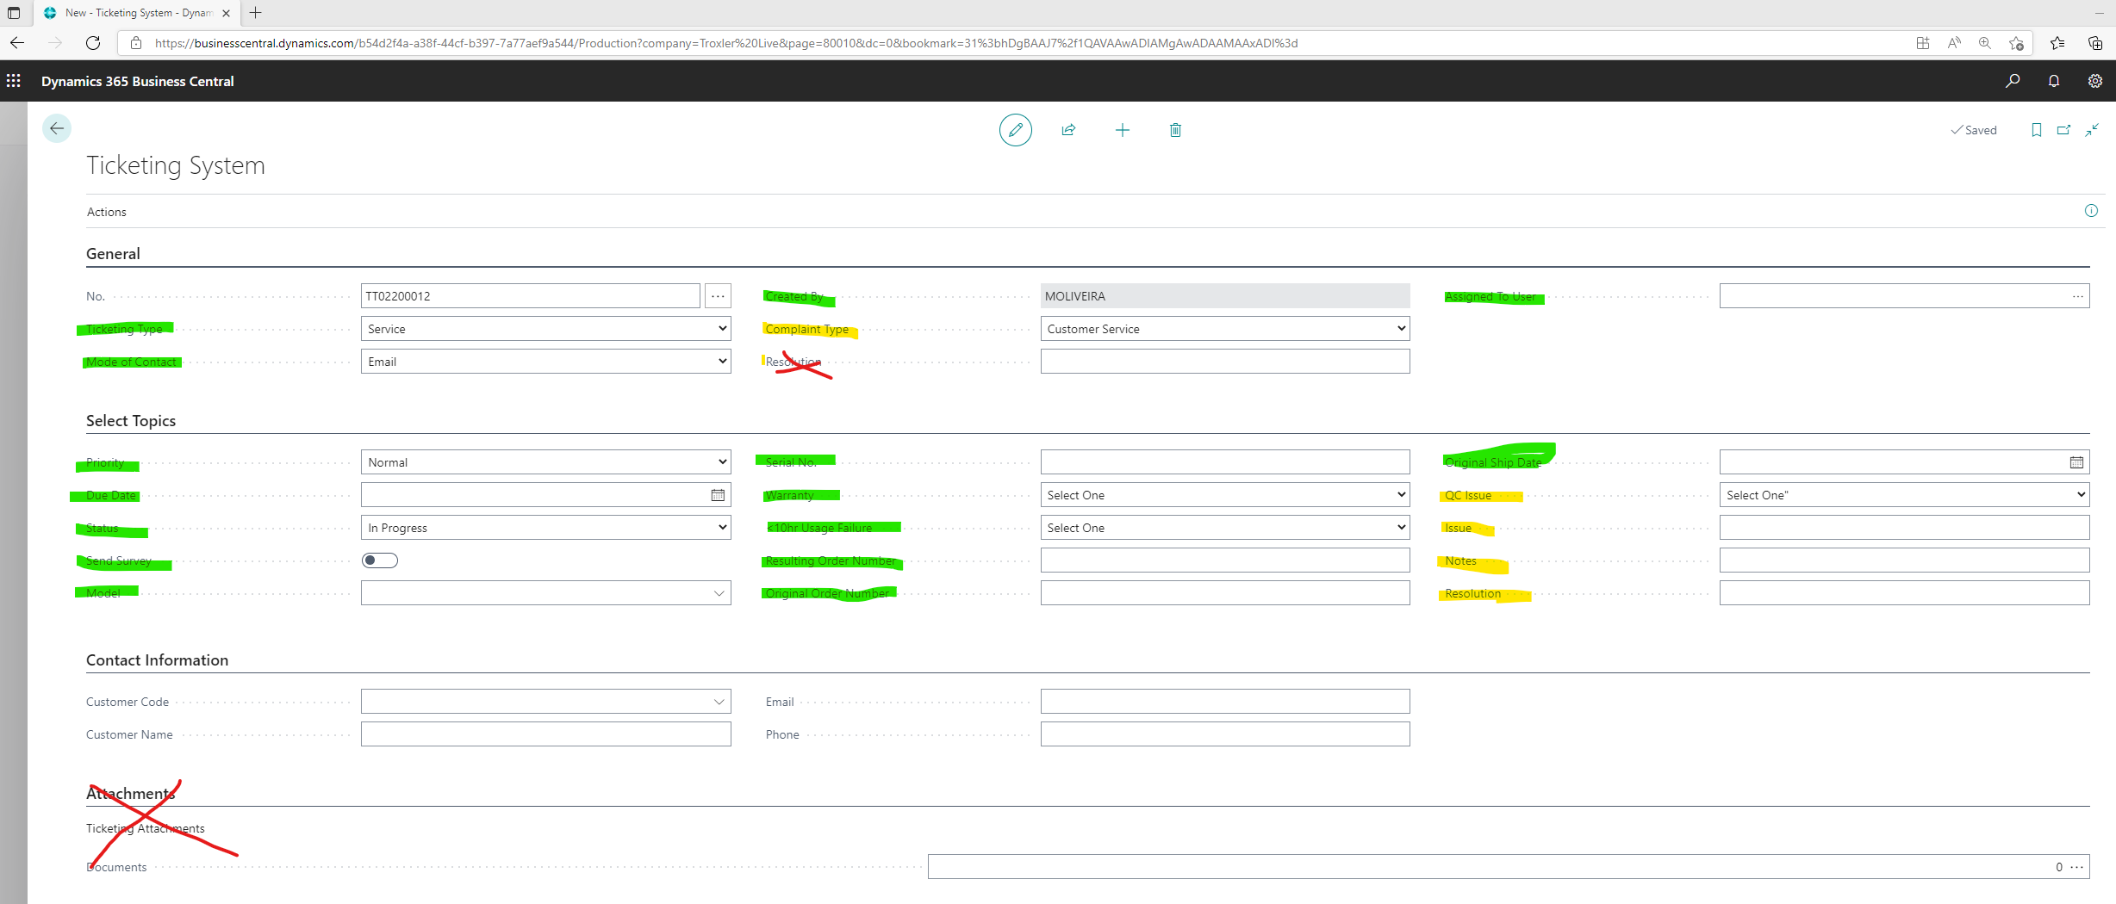
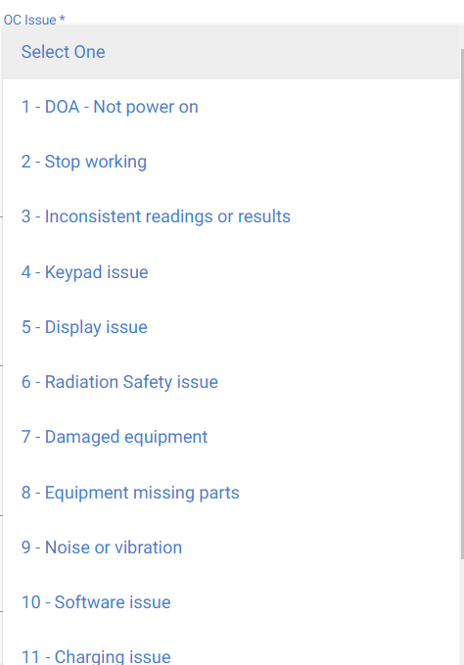
BC Ticket by Troubleshooting Quality
Remove resolution from the General are and create new field [500cc] on the bottom for this
Review the layout and add the 3 fields [issue, Notes, Resolution] on a “spot” as it is the General, Select topics or contact information. You can call this “Details”
Move Contact information after General because this is the sequence during use
QC issue is missing the number before the description –this indicates how critical the issues are [we could create a new ticketing reason master if possible]
Missing add CAR and CAR note after resolution field
Remove “Attachments” form the bottom because is not working – leave the other one
Once populate the SO the shipping date needs to come automatically
Move this to other spot as it is in TTS – visual fields

