Slide 1
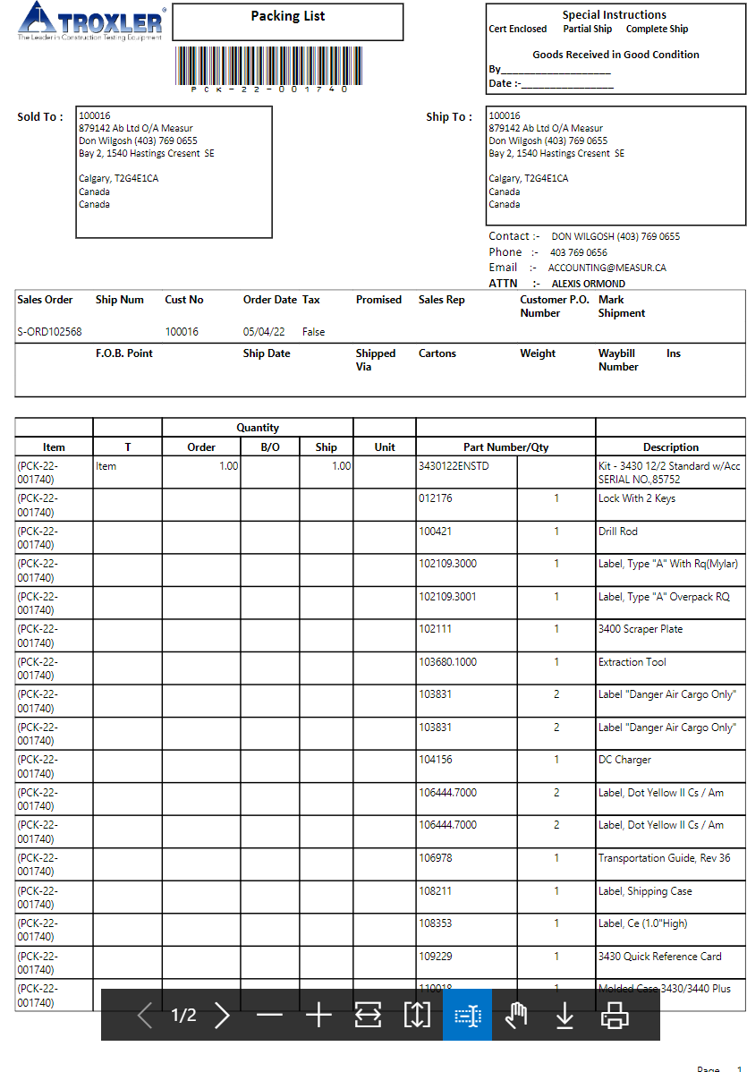
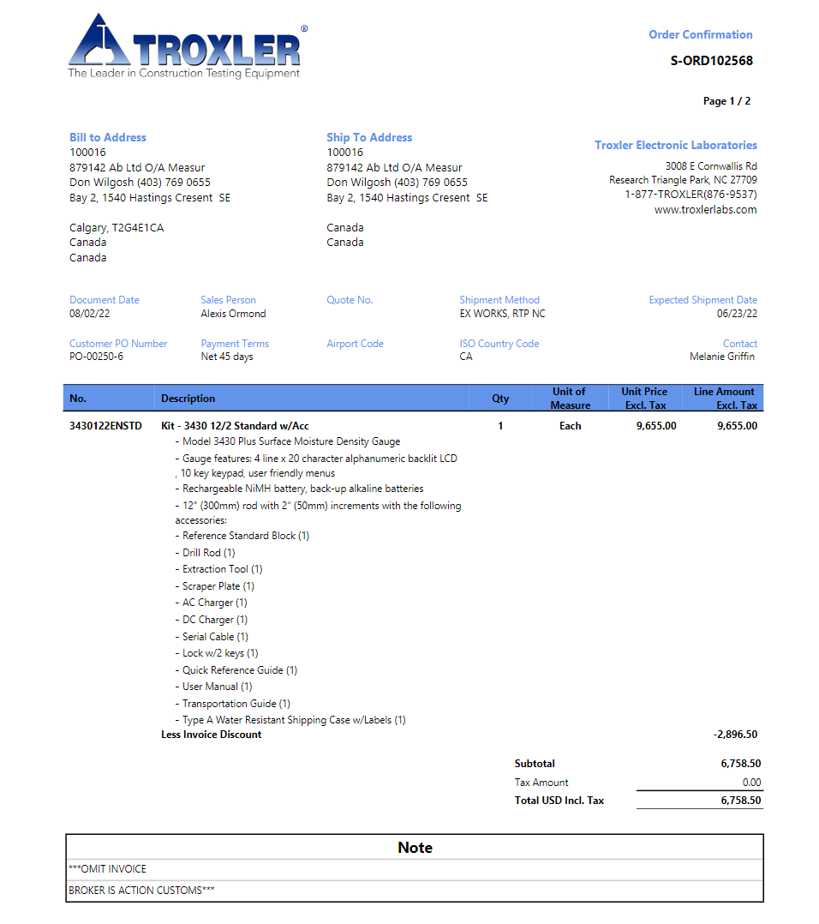
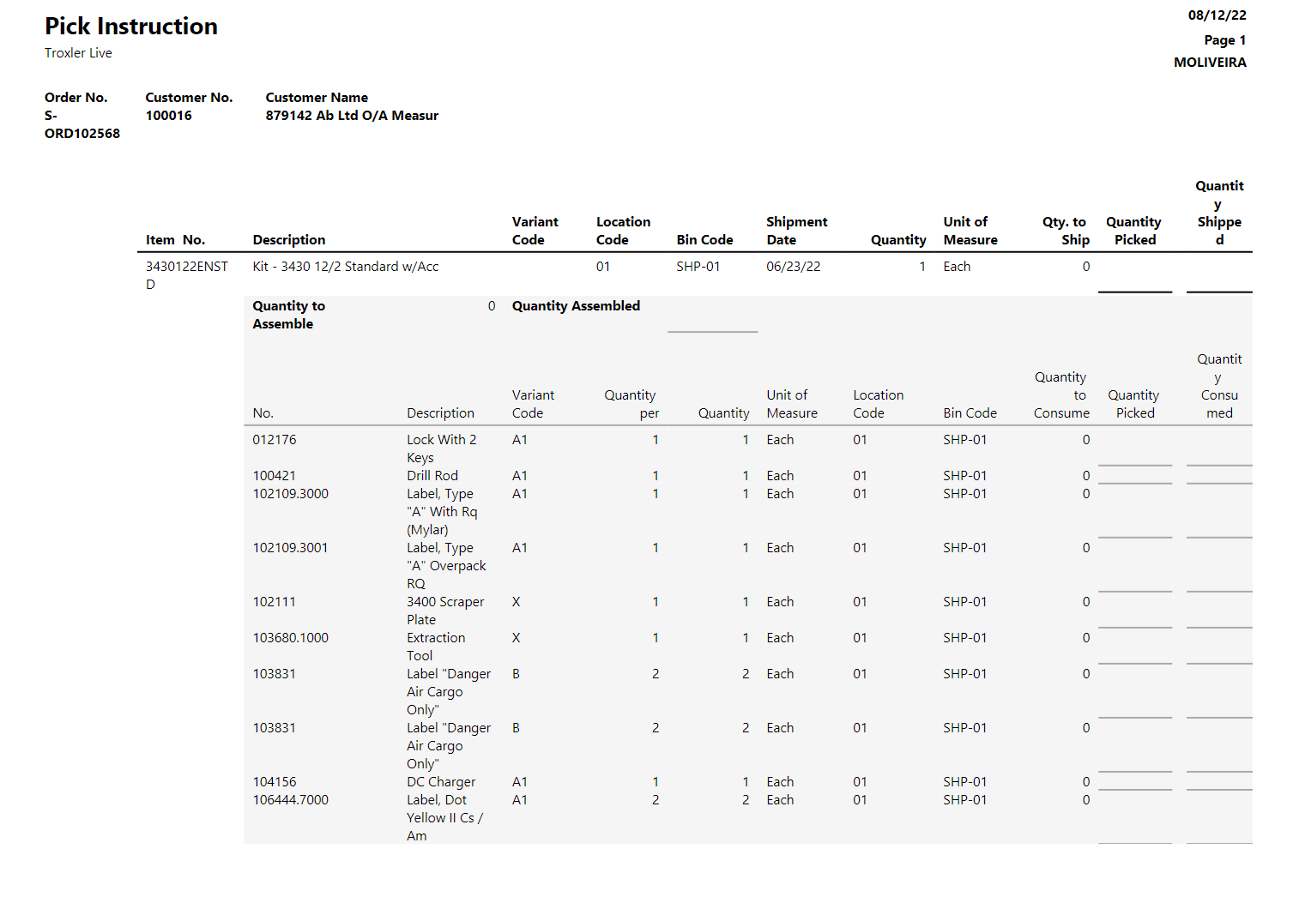
Current Sales Order includes Kit Item + comment fields
SO calls price from kit level
Current picking list calls all items from Assembly BOM and not from Production BOM
There is no SN for serialized items
Current packing list calls all items from Assembly BOM and includes SN for serialized items

Slide 2
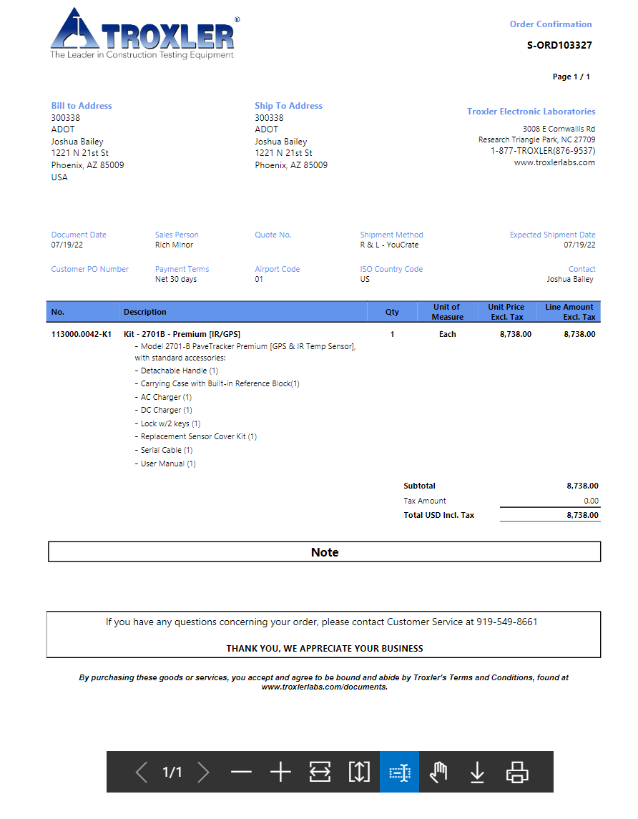
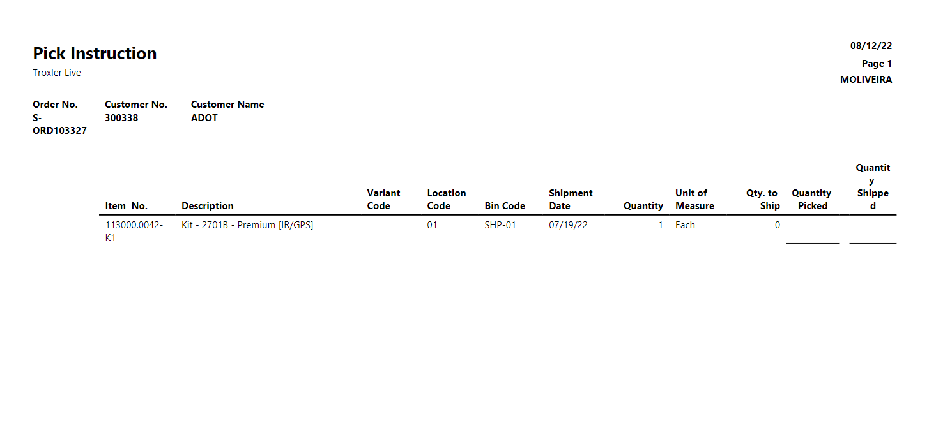
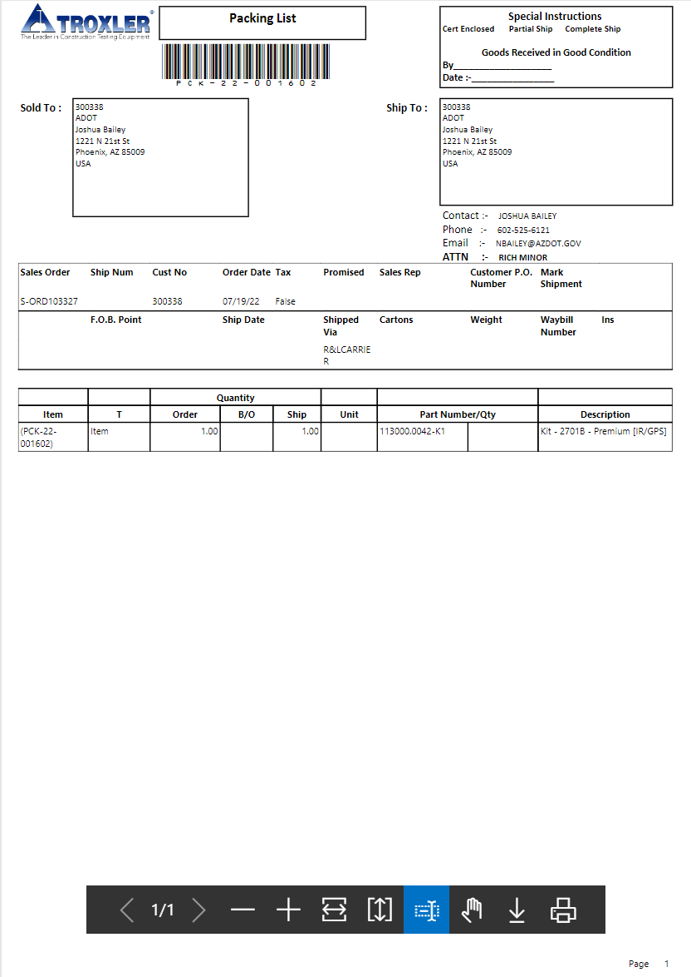
Sales Order – no changes on template, but:
Create new TPN for new kits
Move Assembly BOM to production level
Add all comment fields to new TPN
Move kit price to item level
Redefine the Lead times [define promised date]
Picking list – updates are needed
Picking list will call only the new item line from production BOM
Add SN from production BOM to picking list column
Packing list – updates are needed
Packing list will call the main item line from SO
Add SN from production BOM to packing list description for all Serialized items [can be more than one for each line]

